Slide 1

Senior Project Presentation
Team Flight
Drone Simulator/Controller
May 1, 2015

Slide 2

Introduction
Team Flight consist of members:
Khary Alexcee – Project Manager
Charles Fahselt - Lead Software Developer
Michael Truncale - Lead Drone Developer
Dean Dixon - Software Advisor and Controller Input Specialist
Afif Elias Diek - Graphic Designer and UI Developer
The team was assembled by individuals looking to use there knowledge and skills of software development and computer engineering and apply it to a project
The team decided that the project’s focus will be using modern drone technology and computer gaming development.
Notes:
The title of our project is pretty simple “Drone Simulator/Controller” but that is exactly what it is. We created a piece of software that will allow you to simulate the flight of a quad-copter drone.

Slide 3
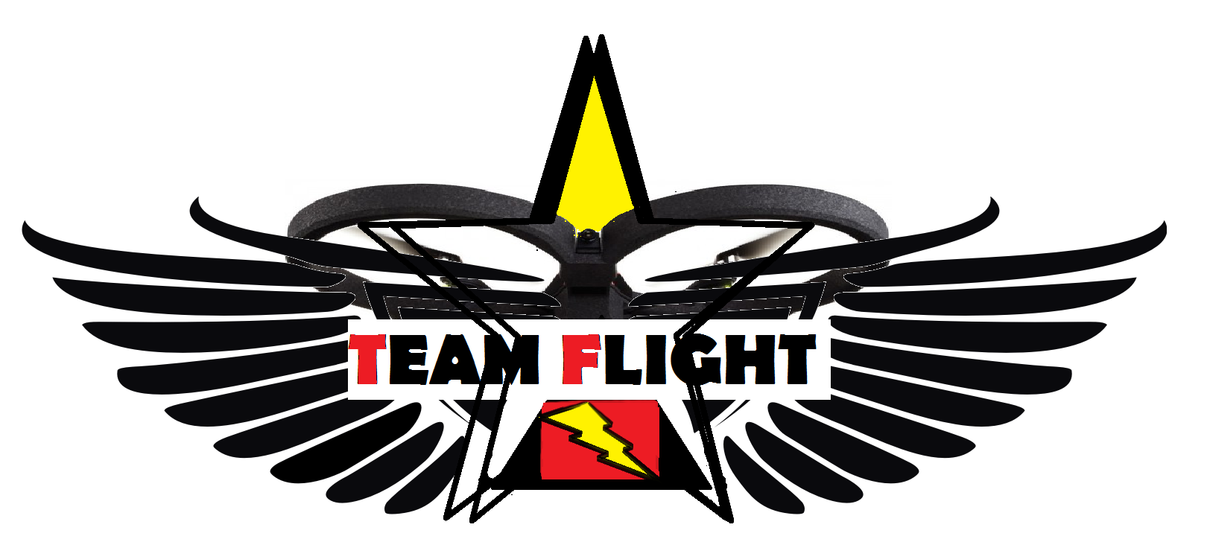
Thus, Team Flight was created…

Slide 4
Background
Drone popularity on the rise
Drone hardware expensive
Drone hardware easy to break, especially for new users
By simulation drone flight we will reduce the risk of drone hardware damage
By doing this we will ultimately lower the cost of drone ownership

Slide 5

What exactly do we want to do?
Software that simulates the control and flight of a drone, connecting and controlling a actual drone
Be able to control drone, real and simulation, with the keyboard and XBOX 360 controller
All software function be ran with one single program
Simulation mimic the flight of the actual drone
The actual drone be controlled through the same program
Simulation has game like challenges

Slide 6
Users
Professional drone users – want to further enhance their skills or try other drone platforms in simulation
Novice drone users - want to practice drone flight in a safe environment or see if they are interested in the drone flight field
Commercial users - want to use drone flight as stable platform for photography, want to use drone flight for other commercial purposes

Slide 7
Risk
Damage or loss of test drone
Drone related injuries to team members or other users
Legal restrictions regarding drone flight
Complexity of project in regards to tying together the software and hardware platforms
Difficulty in modeling the physics involved in realistic drone flight
Interference with wireless signals and communication problems between software and drone

Slide 8




Collaboration
Email
Google Hangouts
Google Drive
GitHub
Blackboard
Face-to-face meetings

Slide 9
Meeting time
Team meetings will occur Monday and Wednesday from 2:00 – 4:00
Work flow will be monitored by discussing weekly team progress in our
Tuesdays from 4:00 – 7:00 and any additional times if needed by
prearrangement.

Slide 10
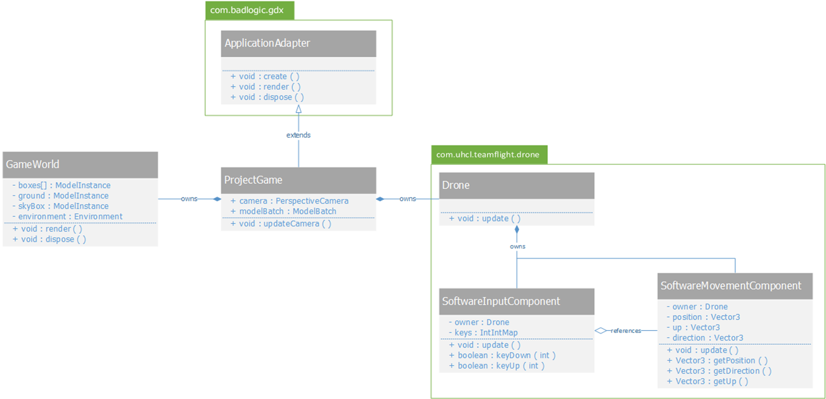
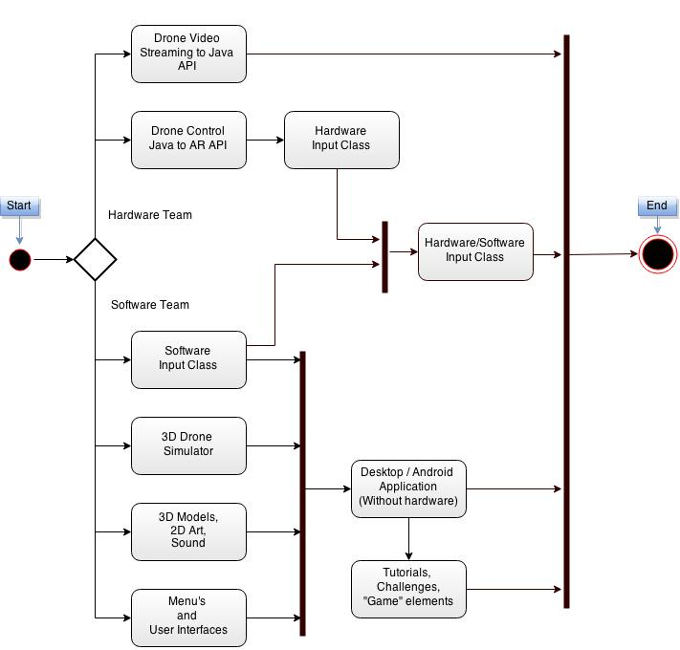
Documentation
Project Charter
Project Vison, Scope, & Plan
Requirements Document
Design Sketches
UML Diagrams
Testing Plan
Weekly Individual Reports
Weekly Team Reports

Slide 11
How exactly did we do it?

Slide 12
Charles Fahselt
Lead Software Developer
Team Flight

Slide 13
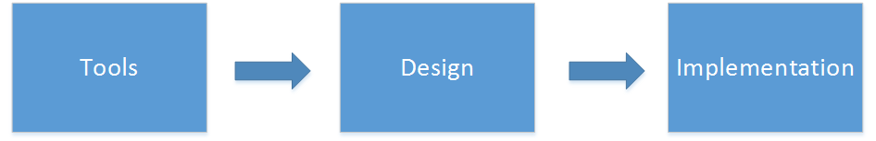
Presentation Overview

Slide 14





Software Tools
Languages: Java, Javascript
Frameworks: LibGDX, Node.js
Build Automation: Gradle
Source Control: Git
Notes:
EXPLAIN EACH, WHAT THEY DO. DETAILS
Java
Used for software
Explain how we were considering using Unity, but decided against due to problems concerning hardware connectivity

Slide 15
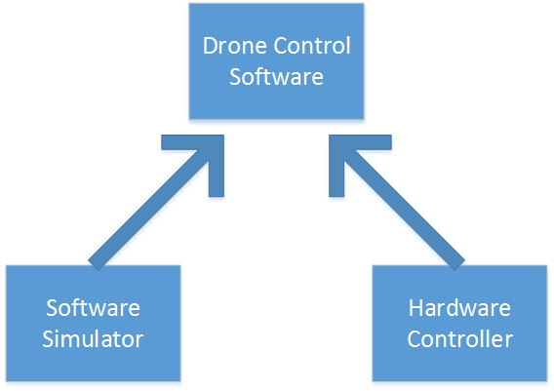
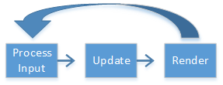
Design: Separation of Concerns
Macro
Hardware / Software
Micro
Update / Render
Notes:
Separation of concerns between hardware and software.
Some classes, such as basic user interface elements, are re-used between the two paradigms, but otherwise they are separate to ease development.
Seperation of

Slide 16
Design: Maze Generator
“Digger” algorithm
Procedurally generates a 2D array
Unique level geometry each play
Level class
Converts 2D array into 3D objects
Collision physics via Bullet

Slide 17
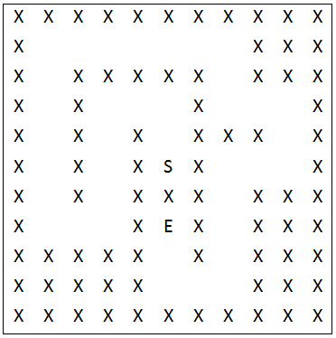
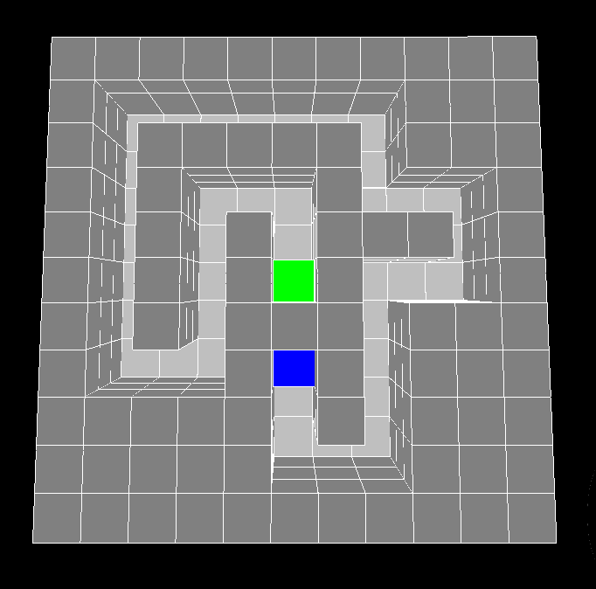

Map Conversion
Generator Output
3D Level

Slide 18
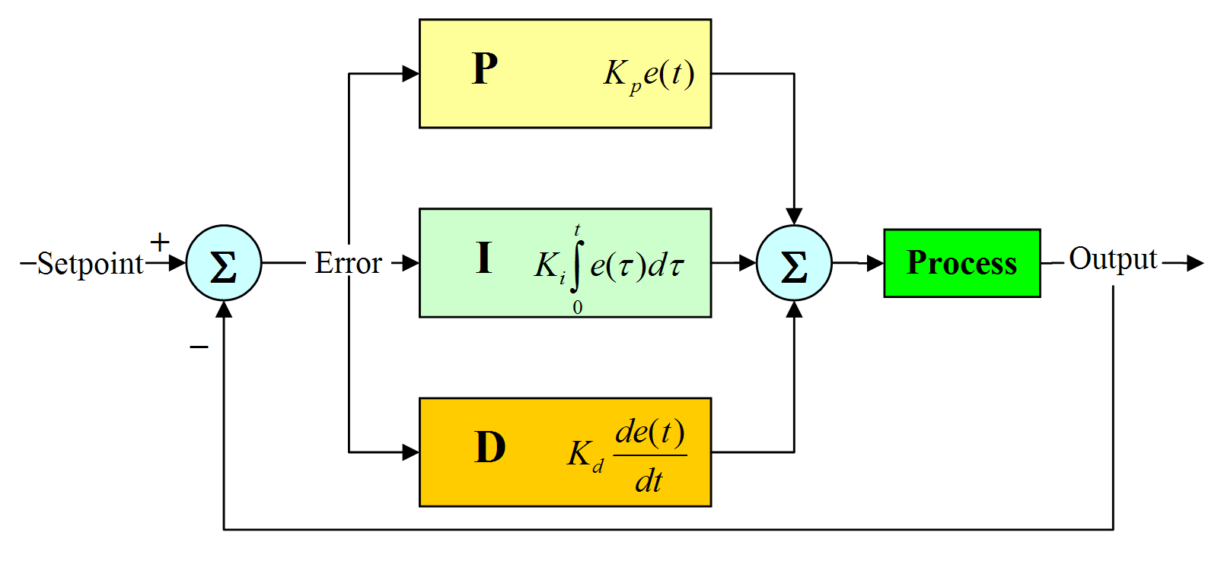
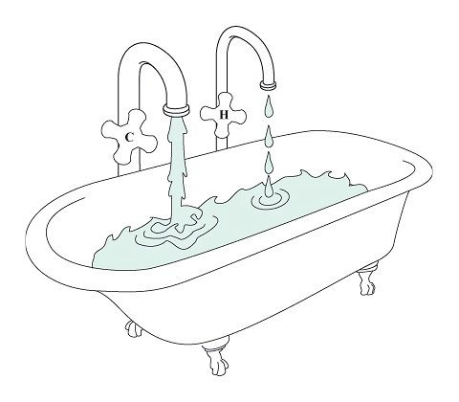
Implementation
Screens
State Pattern
PID Controller
Notes:
Screens keep things seperate and are a logic abstraction made by LibGDX.
State pattern is used to control game states within a screen. The main play screen has many states it can be in, including Playing, Paused, Resumed, Ended. Each state determines how the program should act under certain circumstances. They are used to reposition the play after a collision, or after the game has ended to replace the player at the beginning..
PID Controllers are control loop feedback mechanisms widely used in industrial processes. PID’s calculate an error value from an Expected and an Actual value, then attempt to respond to changes in the output by adjusting the inputs.
BATHTUB EXAMPLE

Slide 19
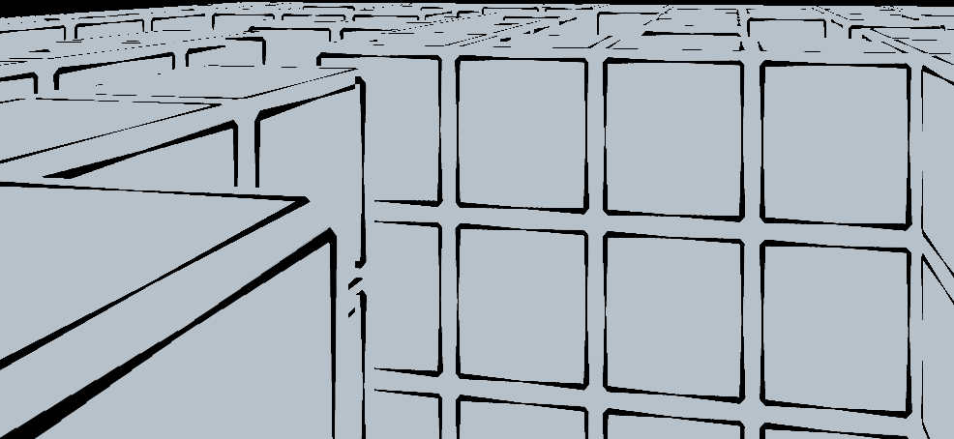
Implementation: Issues
Blender 3D Models and Physics
Textures Vs. Collision
Notes:
Initially, Making 3D models via blender seemed like a great idea. In one program, we could Model the entire structure of the level, Texture it, and export it it straight into our software via LibGDX built-in functions.
But these proved to be more hassle than they were worth, as we soon discovered that we could not get our 3D Collision and Physics engine, Bullet, to understand the shapes of objects from Blender.
Eventually we settled for Texture-less 3D models, and opted for a Procedural generation approach, through our map generator.

Slide 20
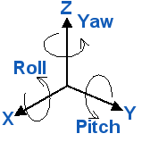
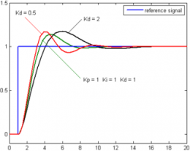
Implementation: Issues
3D flight control
3D vector manipulation
Stability
Per-Axis PID controllers
Notes:
3D Vectors: Position, Up, Direction,
Difficult math involved, especially via limiting tilt angles
Stability:
We had the problem of re-centering our in game “UP” axis. Inspired by real quadcopters, we decided to implement one PID controller per control axis to re-center all controls. Whenever controls are released, they automatically center and attempt to bring the quadcopter to a halt.

Slide 21
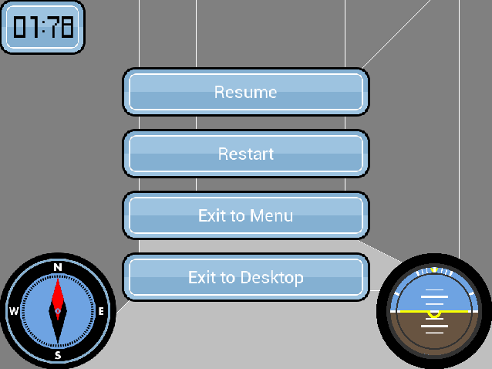
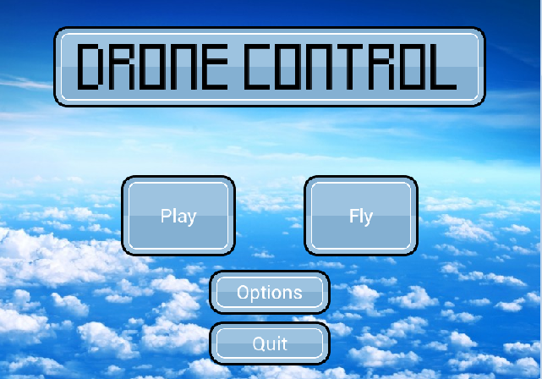
Implementation: User Interface
Scene2D Scene Graphs
Notes:
A 2D scene graph implementation is provided by LibGDX, called Scene2D. We used this extensively, along with a Table-Based layout, to position all of the UI element in our software.
Here you can see some examples of Buttons, Labels, and custom UI elements we created such as the Compass and Attitude indicator.

Slide 22
Name: Afif Elias Diek
Title: Graphic Designer and UI Developer
Duties :
Design graphic
Improve UI Design
Create Art Assets

Slide 23
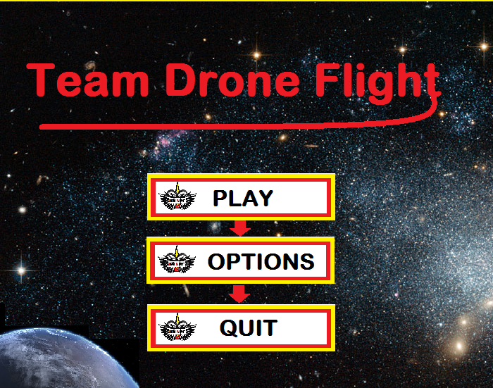
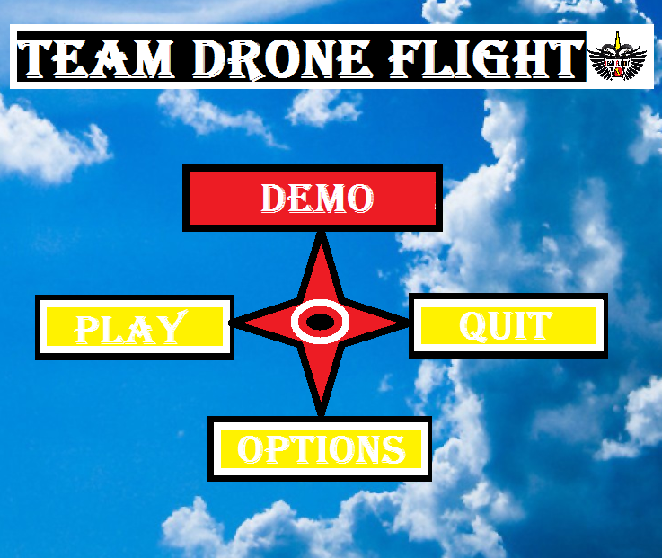
Menu Options

Slide 24
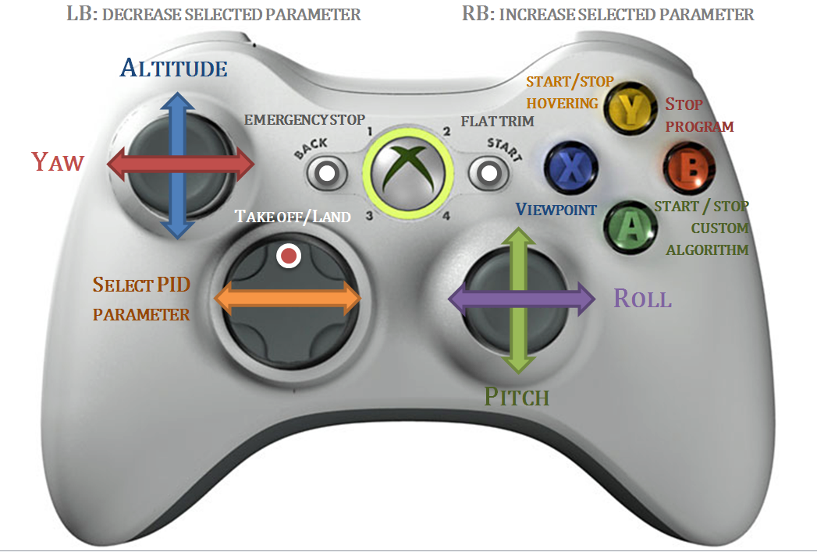
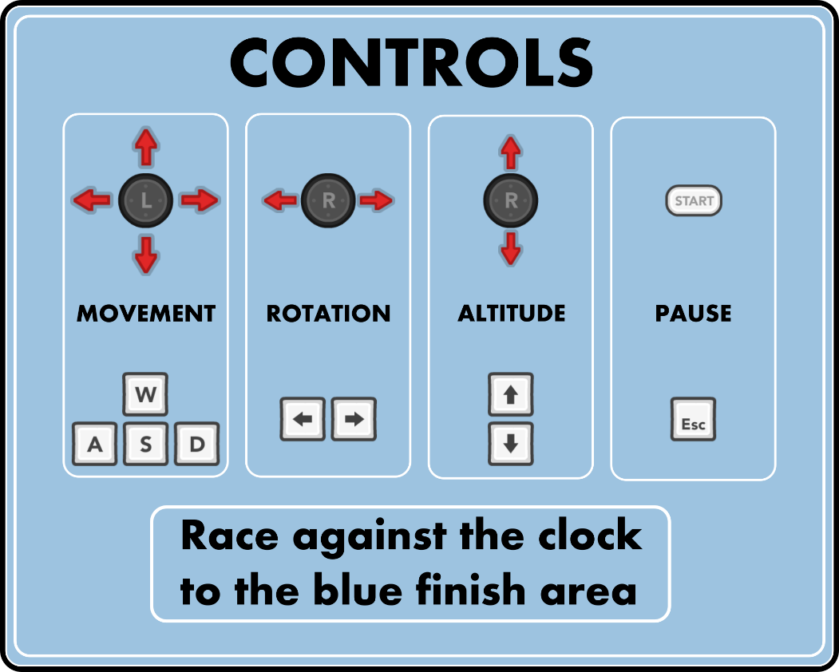
Controllers Graphics

Slide 25


Logos

Slide 26



Tools used for Graphics
Adobe Photoshop CS6
Selection tools ( Marquee Tools , Magic Wand Tool)
Image editing tools ( Blur tool, burn tool, Clone Stamp tool)
Paint
Select, Brush, Magnifier, Fill with Colors and others
Adobe Illustrator CS6
Painting tools ( Paintbrush, Gradient)
Reshaping tools ( Rotate, Reflect, Scale)

Slide 27
Integration into Software
Software needed GUIs
Developer came up with a specific look that needed to be created
Designs where specific to the program
The user interface need to be easy to use and understand
And also look good!!!

Slide 28
Name : Dean Dixon
Title : Co-Software Side Developer
Duties
Advised and collaborated with Charles on making the software side of the project.
Input
UI control

Slide 29
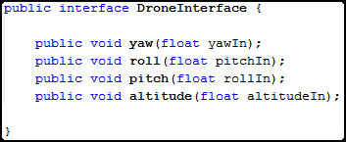
Drone Interface
The Drone class implements an interface called DroneInterface
The interface contains the four methods used to alter the drone’s movement.

Slide 30
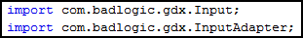
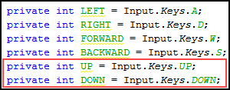
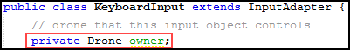
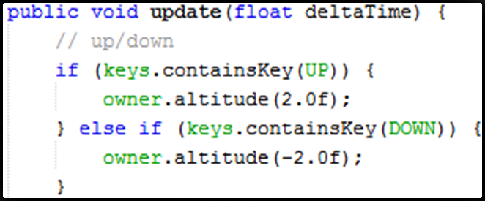
Keyboard Input
The KeyboardInput class uses LibGDX’s built in Input extension to bind keys to variables.
The class has a Drone variable named owner to reference the drone that it controls.
The KeyboardInput class then reads keys in its update( ) method and calls the drone’s methods to alter it’s movement based on the key entered.
Up and Down Example

Slide 31
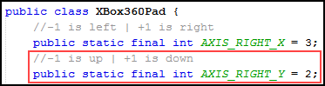
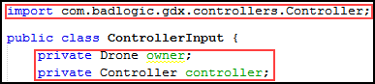
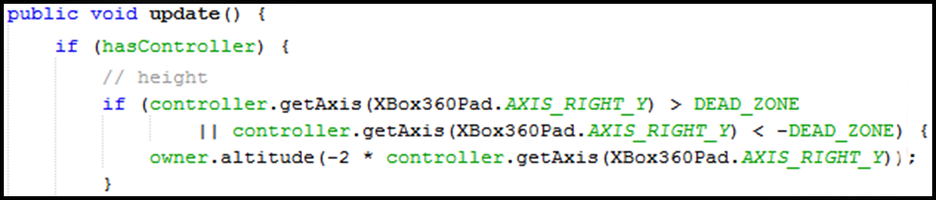
Xbox Controller Input
The Xbox360Pad class binds variables to the Xbox controller’s analog stick axes and buttons.
The ControllerInput class uses LibGDX’s built in ‘Controller’ extension to read inputs from the Xbox controller.
ControllerInput also has it’s own Drone named owner as well, to alter the drone it’s controlling just like the keyboard.
The ControllerInput class then reads keys in its ‘update()’ method and calls the drone’s methods to alter it’s movement based on the key entered.
Up and Down Example

Slide 32
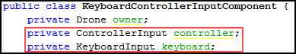
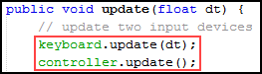
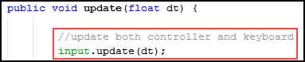
How they work together
The KeyboardControllerInputCompnent has one of each input class as variables, and an update() method that calls the input’s update() methods. It brings both input types into one.
The Drone class has a KeyboardControllerInputCompnent , and calls its update method, allowing the keyboard and controller to work at the same time.

Slide 33
UI Control
The UI is made using two built in types of UI elements
Lable (non-clickable text)
TextButton (clickable button)

Slide 34
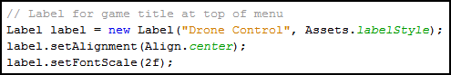

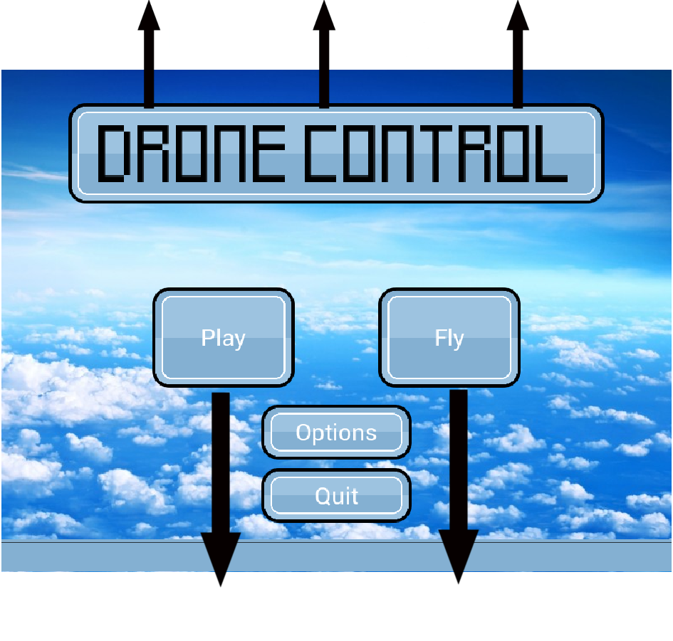
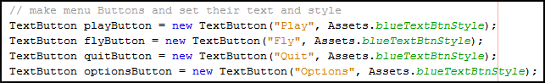
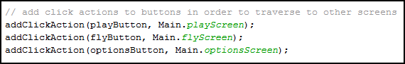

Slide 35
Name: Michael Truncale
Title: Lead Drone Developer
Duties:
Develop software to control the physical drone
Integrate this software with main program

Slide 36
Drone Hardware
Drone:
Parrot brand AR Drone 2.0
Specs:
Quadcopter
Camera (720p)
Wireless (802.11 g), connect to it as router
30 minute flight time
On-board auto stabilization

Slide 37
Controlling the Drone
Node.JS Server using Cylon.JS
Console app – sets up connection with drone through fixed IP / port and takes user input
User commands translated to function calls of Cylon.JS and transmitted to drone for control
Opens read / write sockets to receive commands and transmit flight data to and from main program
“Blackbox”, flight data saved into text file

Slide 38
Integrating into Java
DroneDriver class
Starts Node.JS server
Setups up read/ write sockets on Java end
Handles incoming flight data and video
Transmits out-going commands to Node.JS server
HardwareInterface class
Recognizes user inputs and transmits data to DroneDriver
Various GUI components
Displays flight data (altitude, battery, etc…)
Data pulled from “blackbox” text file

Slide 39
Drone Video
TCP video stream (fixed IP / port #)
H.264 (MPEG 4.10 AVC) video compression
Stream wrapped in proprietary encapsulation called PaVE (Parrot Video Encapsulation)
Implementation:
PaVeParser.JS (Written by: Felix Geisendörfer)
Broadway.JS (Written by: Michael Bebenita)
DroneVideo.JS ties it together
WebGL canvas loaded through web browser

